Slide 1
Introduction to Machine Learning
Goetz Botterweck

Slide 2
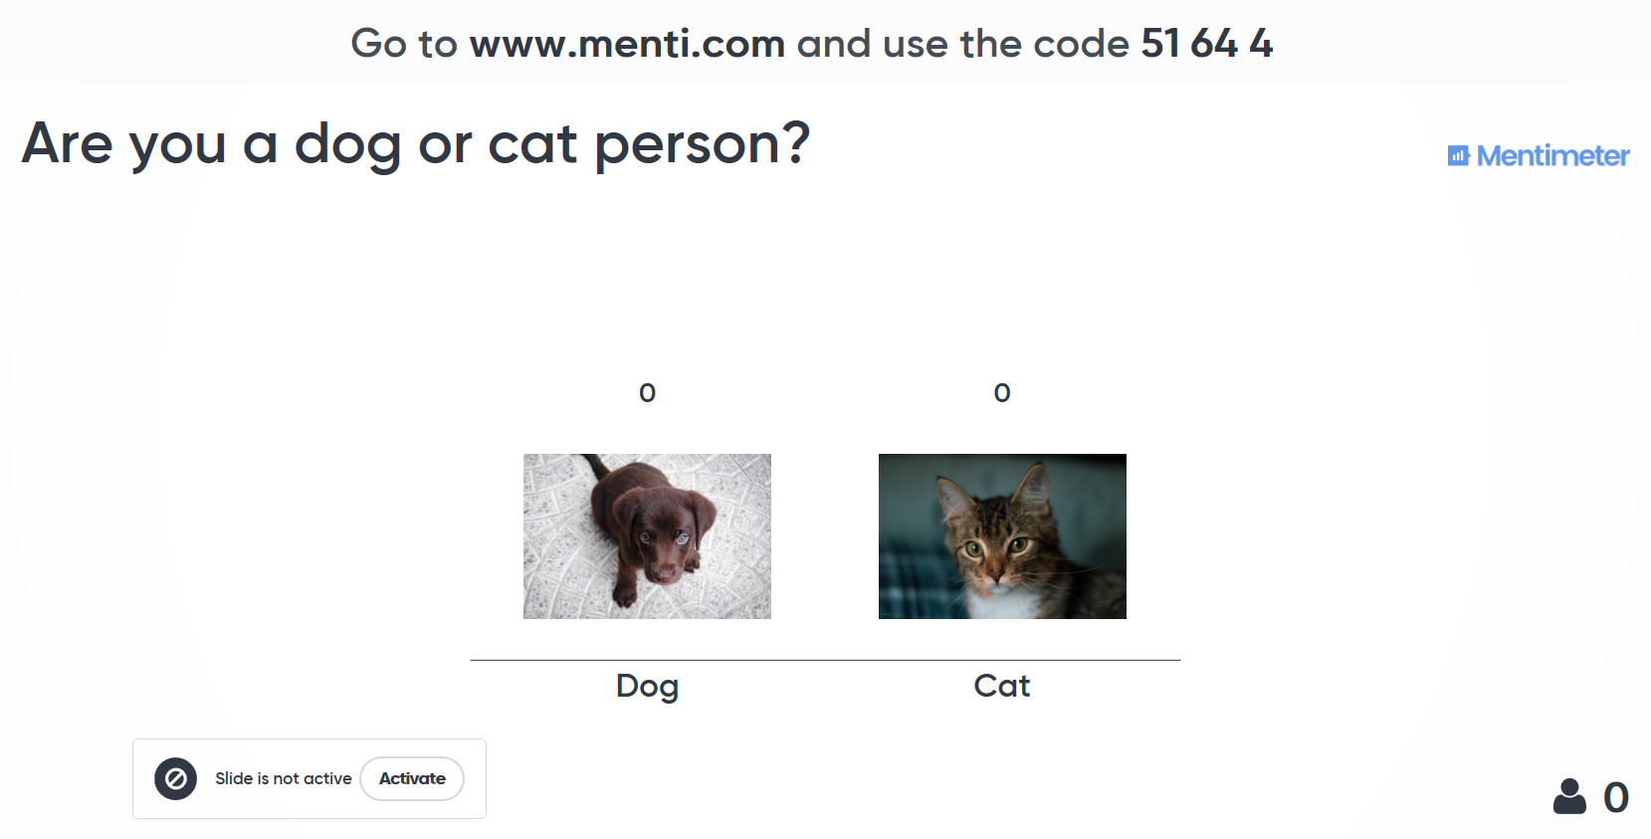
Mentimeter Test Run

Slide 3
1. Overview

Slide 4
Overview
This Talk
Overview
Supervised Learning
Unsupervised Learning
What is ML?
Wrap-up

Slide 5
Overview
This Talk
Overview
Supervised Learning
Unsupervised Learning
What is ML?
Wrap-up

Slide 6
Learning Objectives
Know and understand techniques
Cognitive
On successful completion of this module, students should be able to:
LO1. Explain basic concepts, techniques, and possible applications of machine learning
LO2. Analyse a given problem to choose and apply an appropriate machine learning technique
LO3. Explain design considerations and trade-offs associated with choosing and applying machine learning techniques
LO4. Evaluate a given machine learning approach (technique + chosen set-up) with respect to fitness for a given problem and give recommendations on how to improve results
LO5. Identify and apply relevant best practices for machine learning projects
LO6. Develop an implementation of the main steps of selected ML techniques in a programming language, including the translation from conceptual algorithms into code
Affective (Attitudes and Values)
LO7. Appreciate the design challenges associated with machine learning problems, including awareness of non-technical aspects (ethics, privacy, societal effects)
LO8. Participate in team activities in the design process (e.g., collaborating to find, evaluate, and improve potential solutions)
Choose and apply techniques

Slide 7
Acknowledgements
Inspired by and using material from “Machine Learning”, online course by Andrew Ng, Standford University, offered on Coursera
Other references at the end of the slide deck.

Slide 8
2. What is Machine Learning?

Slide 9
Overview
This Talk
Overview
Supervised Learning
Unsupervised Learning
What is ML?
Wrap-up

Slide 10
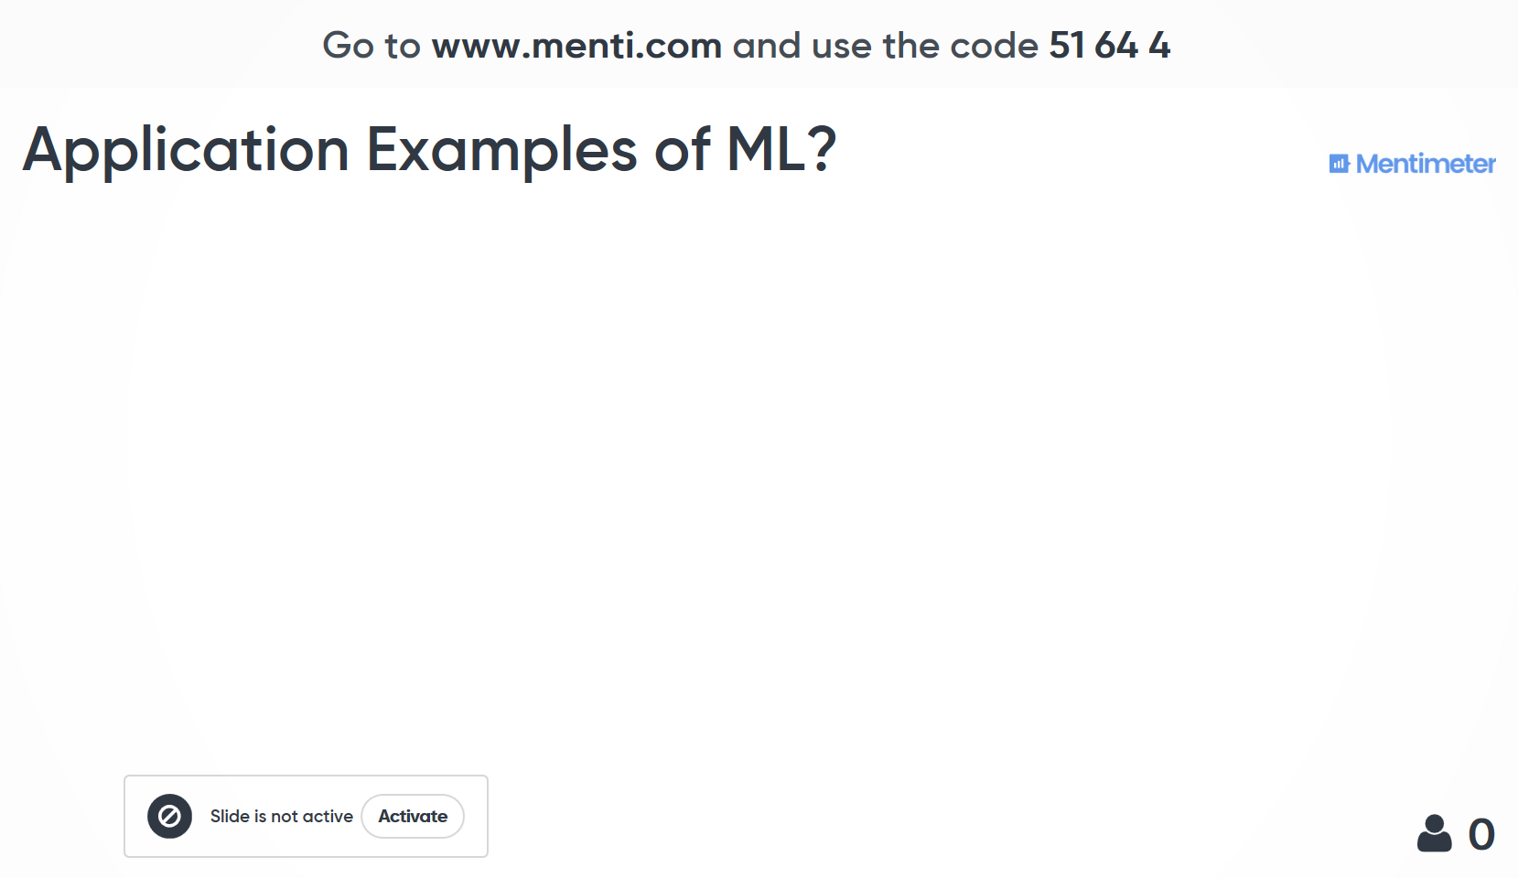

Slide 11
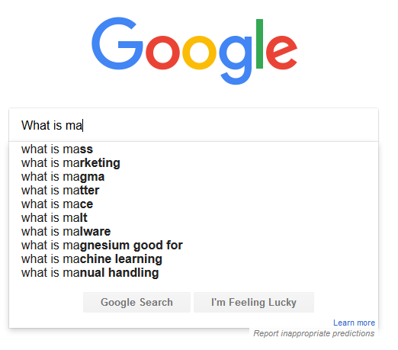
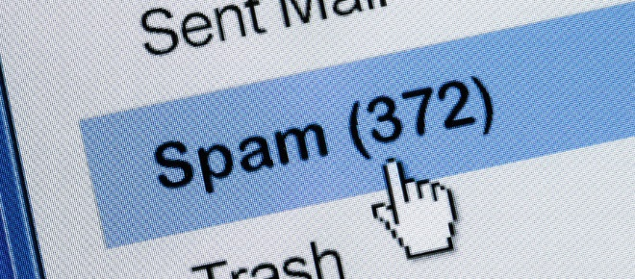

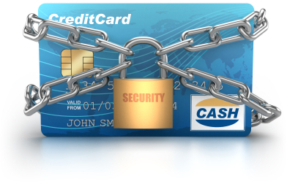
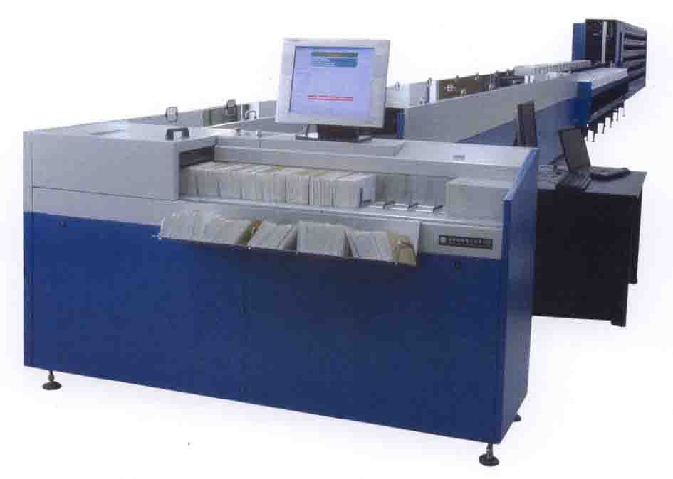
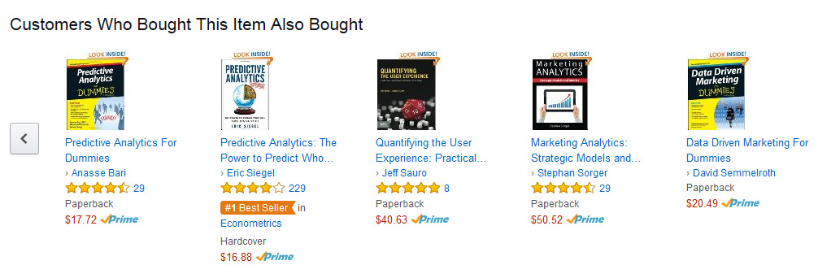
Application Examples
Notes:
You probably use it many times a day without even noticing it.
Every time that use Google search the web, And the machine suggests search terms
Algorithms has learned how to rank web pages.
Recognise friends in Facebook
Spam filtering

Slide 12
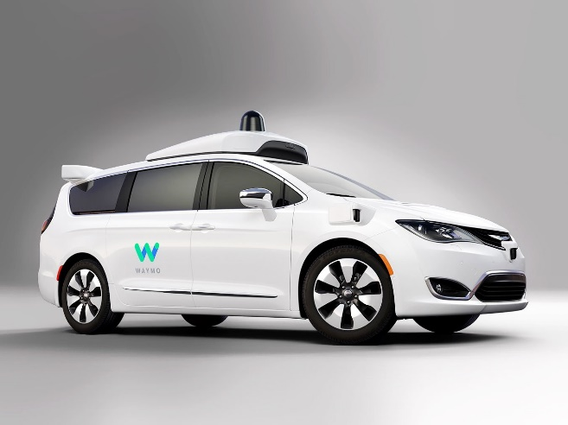
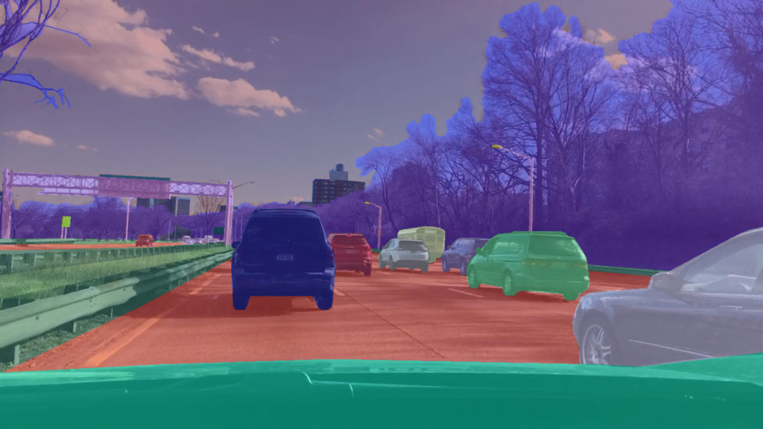
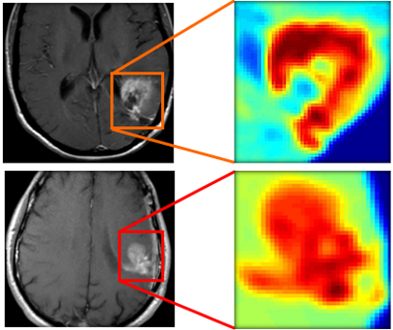
Application Examples
Notes:
http://engineering.case.edu/centers/ccipd/research/computational-diagnostics
https://www.therobotreport.com/uc-berkeley-opens-self-driving-dataset-bdd100k/

Slide 13
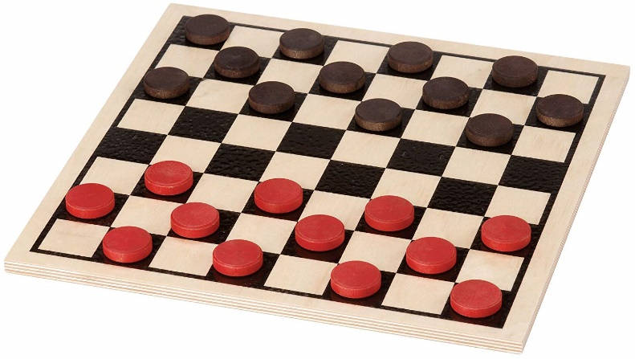
Definition of Machine Learning
Arthur Samuel (1959) “Field of study that gives computers the ability to learn without being explicitly programmed.”
Tom Mitchell (1998) “A computer program is said to learn
from experience E,
with respect to some class of tasks T and
performance measure P
if its performance at tasks in T as measured by P improves with experience E.”

Slide 14
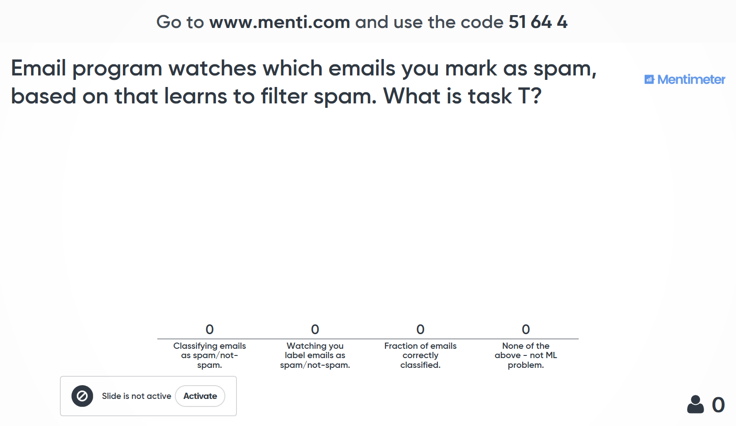

Slide 15
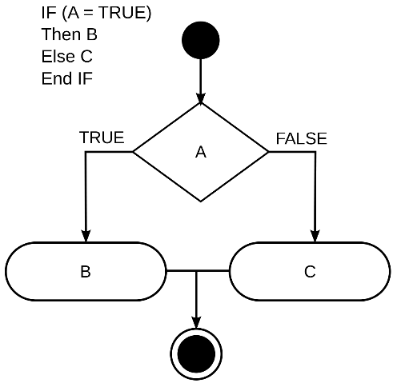
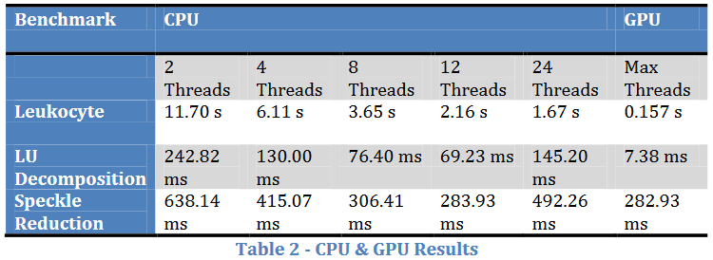
Origins of Machine Learning
Grew out of work in Artificial Intelligence
We can program machines to do solve some problems algorithmicly
eg. sort data, find shortest path in a graph
Other interesting problems are more difficult to encode in traditional programming.
Idea: Machine has to learn completing the task by itself.
Based on recent advances in computer technology
Large datasets available
Computing power available (e.g., using graphics card to speed up computation)
GPU can be 10-100x faster
(Cullinan et al.)

Slide 16
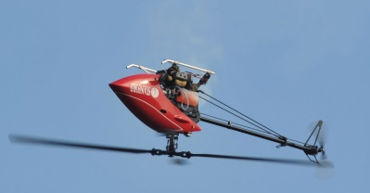
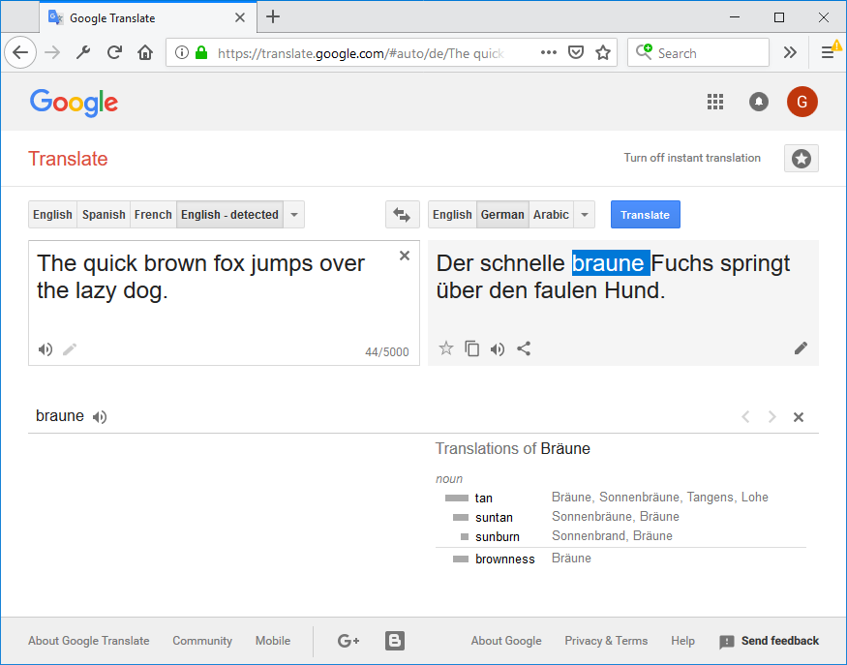
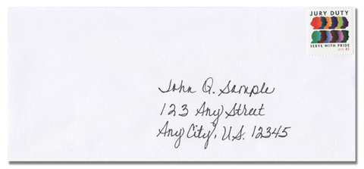
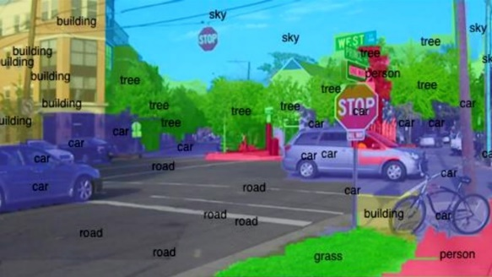
Examples of Machine Learning Applications
Data mining
Large datasets, from growth of the web + automation
e.g., web usage data, electronic medical records, computational biology, data sets in engineering
Applications that cannot be programmed
Autonomous helicopter
Handwriting recognition
Natural Language Processing
Computer Vision

Slide 17

Applications That Cannot Be Programmed Autonomous Helicopter
http://heli.stanford.edu/

Slide 18
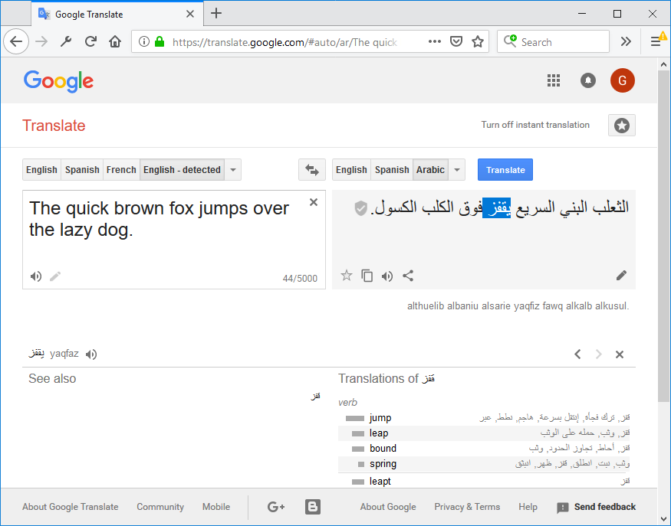
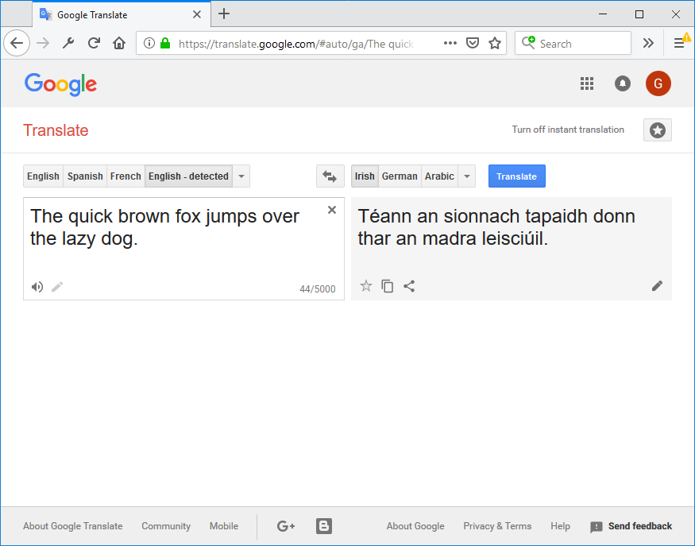
Applications That Cannot Be Programmed Natural Language Processing

Slide 19
Examples of Machine Learning Applications (2)
Self-customizing programs
E.g., Amazon web store, Netflix movie recommendations
Understanding human learning, “Artifical Intelligence”

Slide 20
Kinds of Machine Learning Approaches
Supervised learning – we “teach” the algorithm
Unsupervised learning – we let it “learn” by itself
Reinforcement learning
Recommender systems

Slide 21
3. Supervised Learning

Slide 22
Overview
This Talk
Overview
Supervised Learning
Unsupervised Learning
What is ML?
Wrap-up

Slide 23
Supervised Learning
Right answers are given to the algorithm
Regression: predict continuous valued output (e.g., price)
Classification: discrete valued output (e.g., medical test 0 or 1)
Notes:
features, infinite number of features, SVM

Slide 24
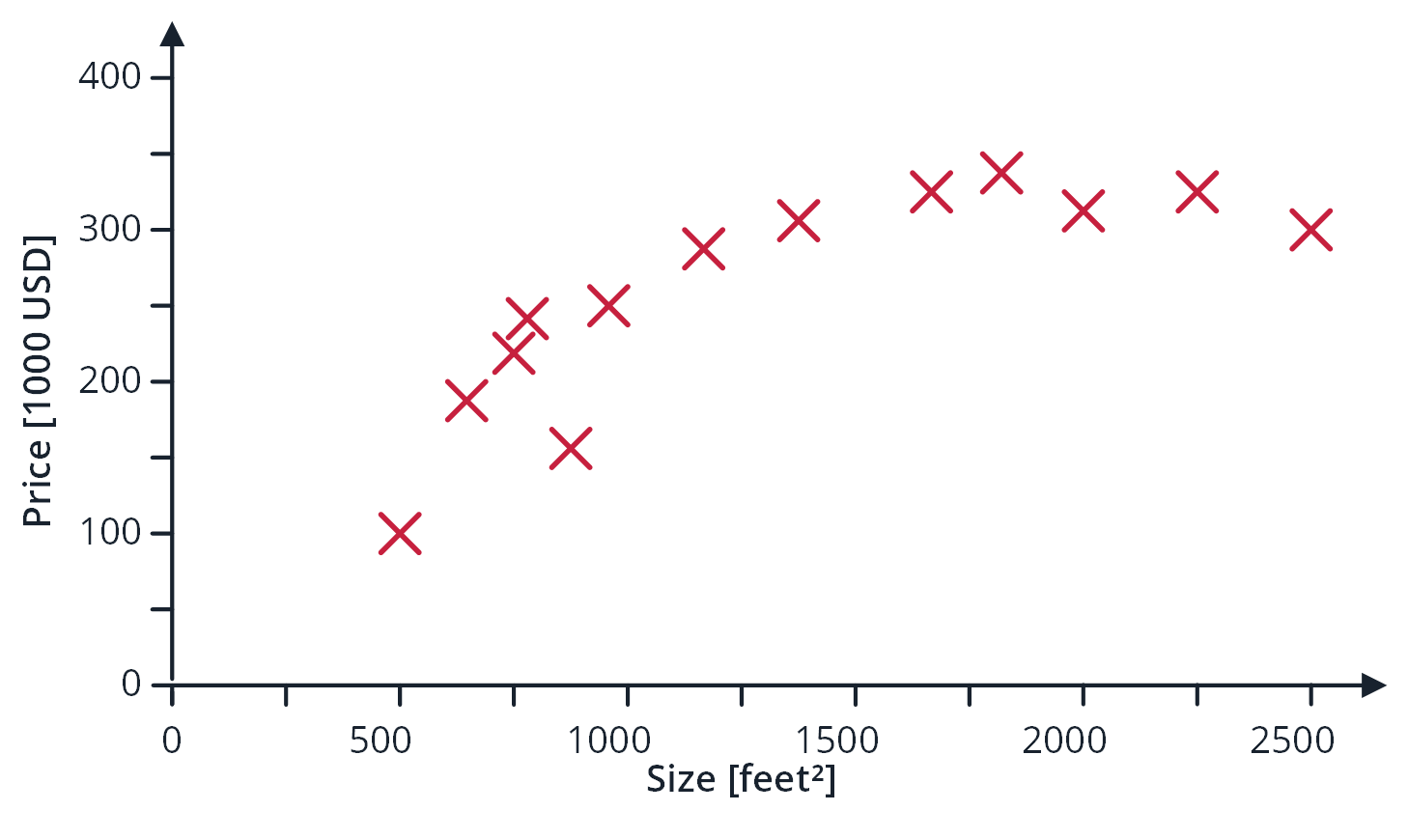
Housing Price Prediction

Slide 25
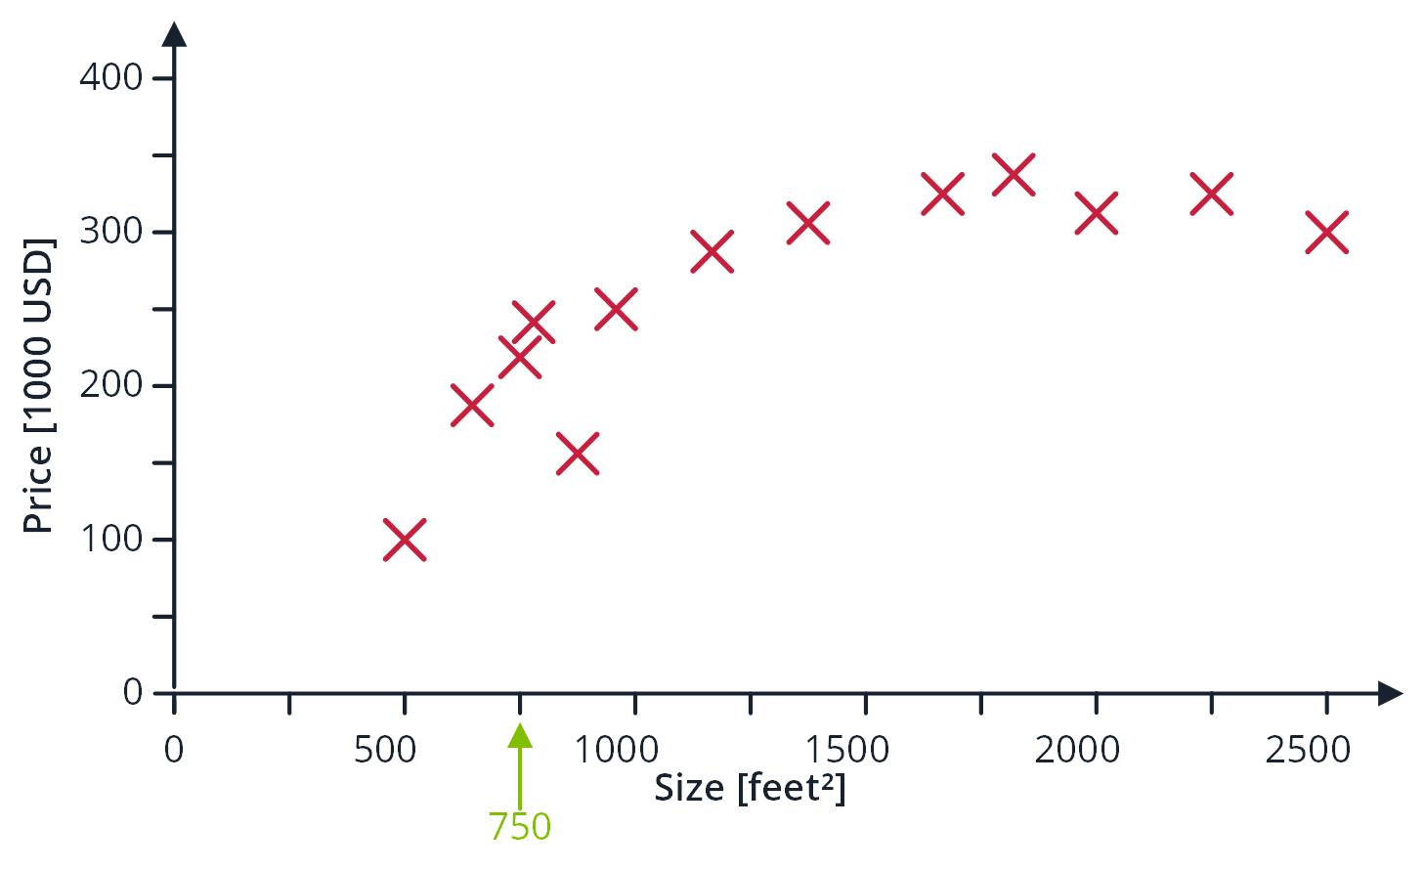
Housing Price Prediction

Slide 26
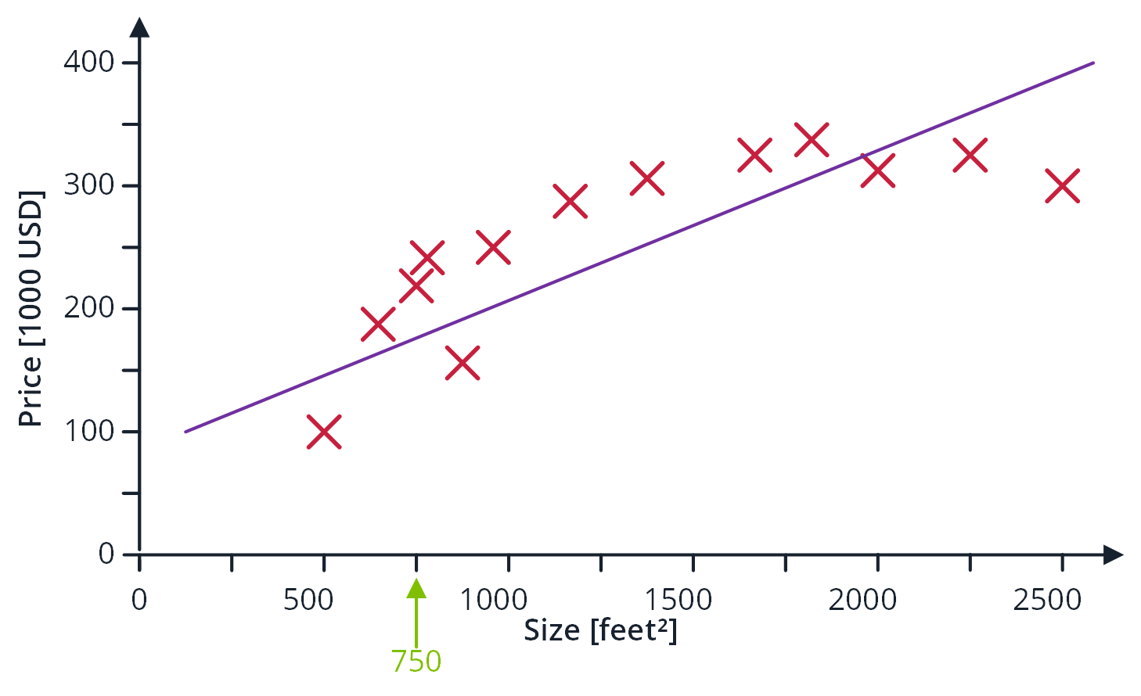
Housing Price Prediction

Slide 27
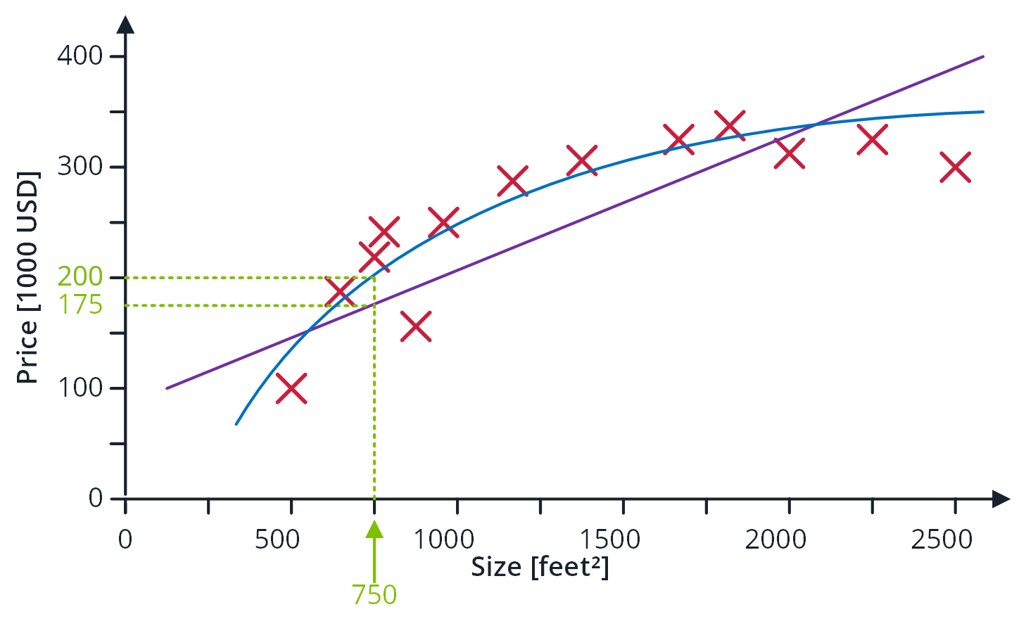
Housing Price Prediction

Slide 28
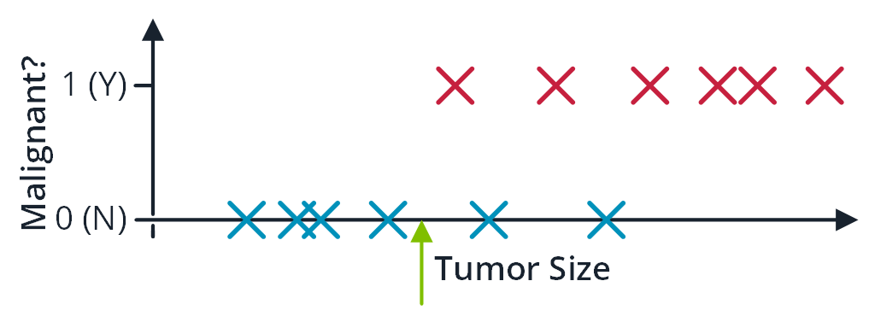
Breast Cancer (malignant, benign)

Slide 29
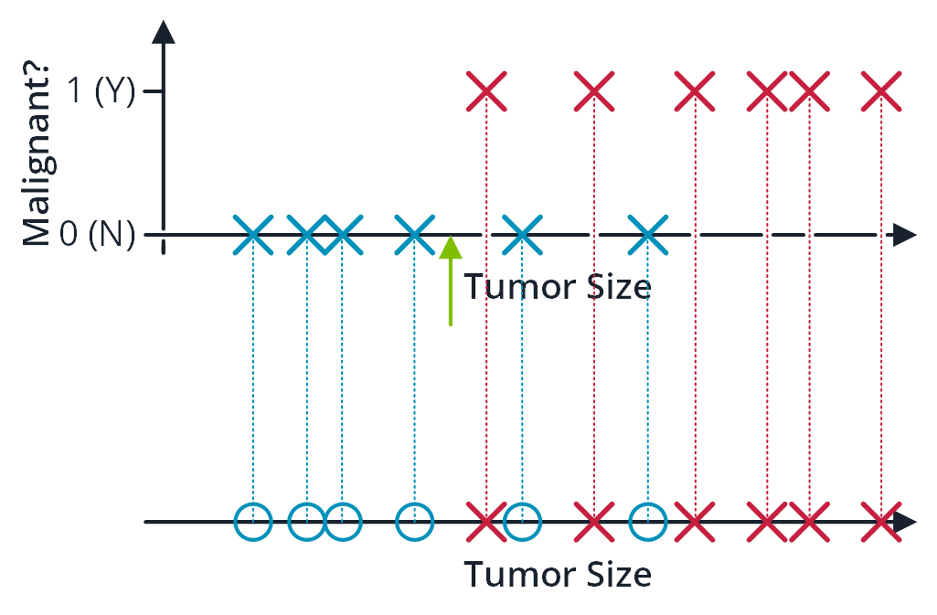
Breast Cancer (malignant, benign)

Slide 30
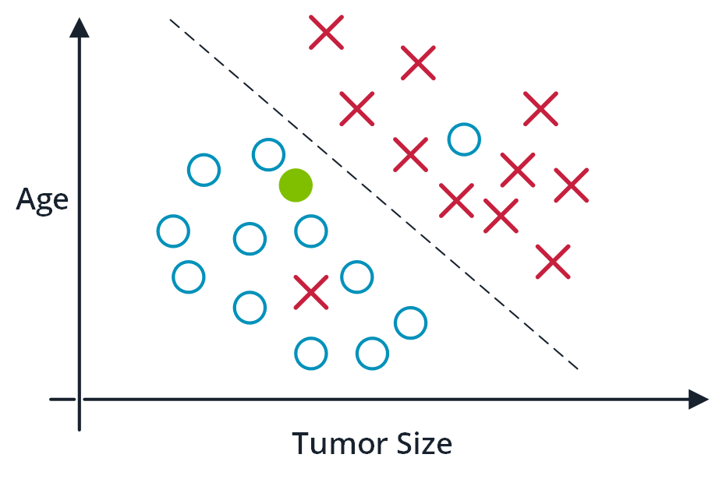
Breast Cancer (malignant, benign)

Slide 31
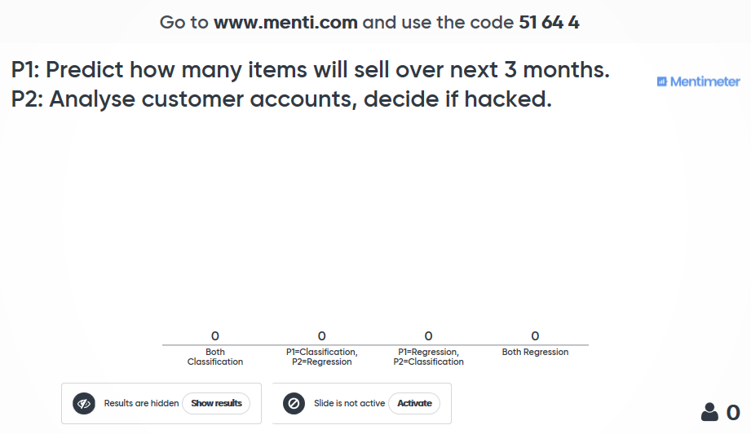

Slide 32
4. Unsupervised Learning

Slide 33
Overview
This Talk
Overview
Supervised Learning
Unsupervised Learning
What is ML?
Wrap-up

Slide 34
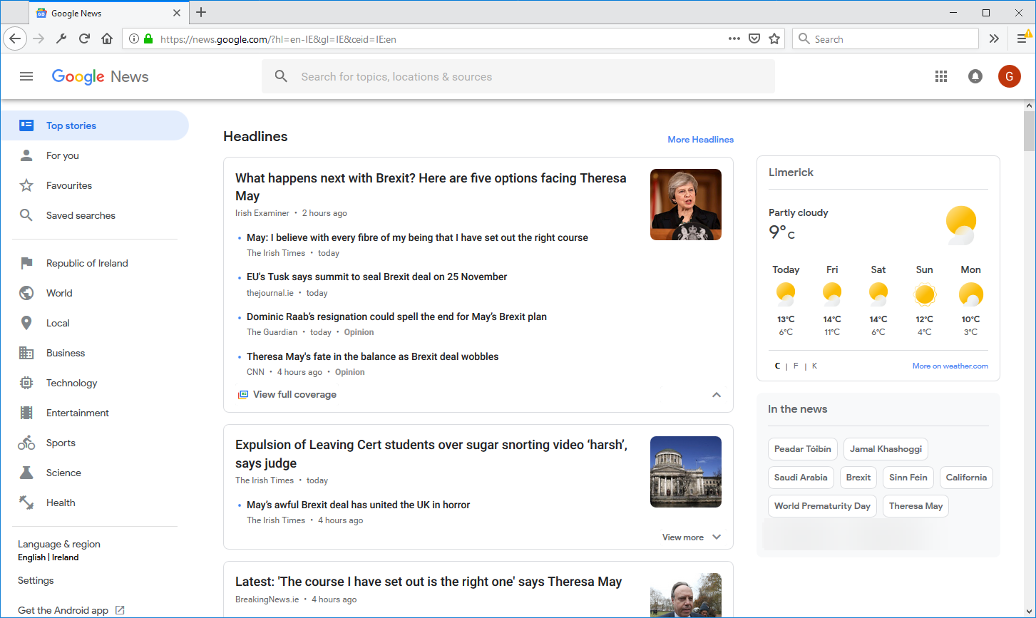
Grouping News Articles

Slide 35
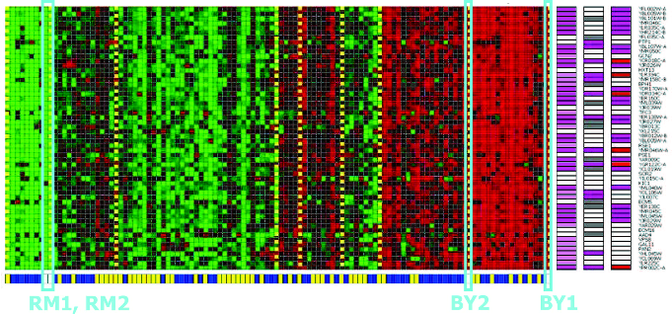
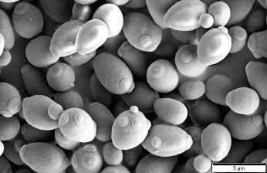
Identifying Regulatory Mechanisms
Clusting of Individuals Based on Their Genes
Genes
Brewer’s yeast.
Individuals
(Lee et al. 2006)

Slide 36
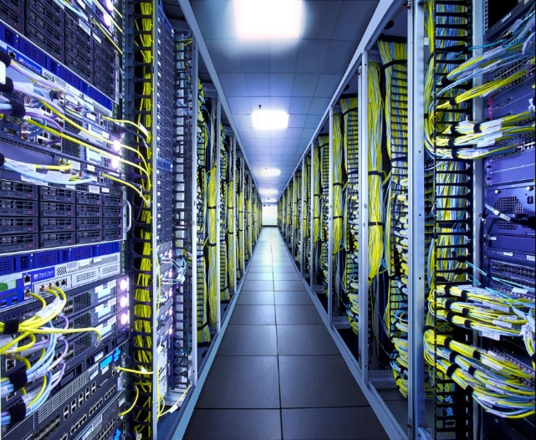
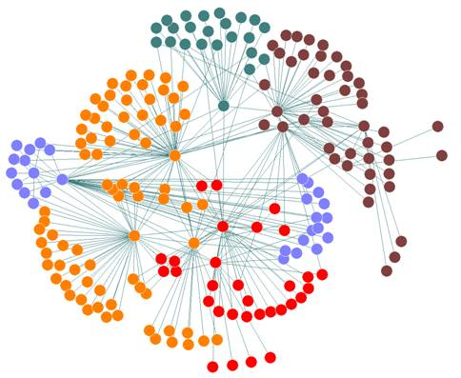
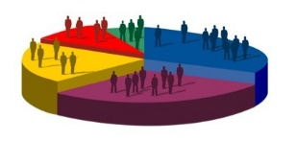
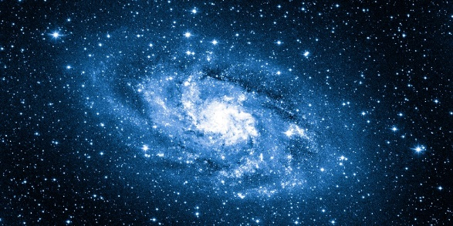
Other Applications of Unsupervised Learning
Organisation of Computing Centres
Social Network Analysis
Market Segmentation
Astronomical Data Analysis

Slide 37

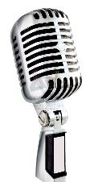



Cocktail Party Problem
(Lee et al. 1998)

Slide 38
Cocktail Party Problem
[W,s,v] = svd((repmat(sum(x.*x,1), size(x,1),1).*x)*x’);
(Sam Roweis, Yair Weiss, Eero Simoncelli)
https://stackoverflow.com/questions/20414667/cocktail-party-algorithm-svd-implementation-in-one-line-of-code
https://en.wikipedia.org/wiki/Singular_value_decomposition

Slide 39
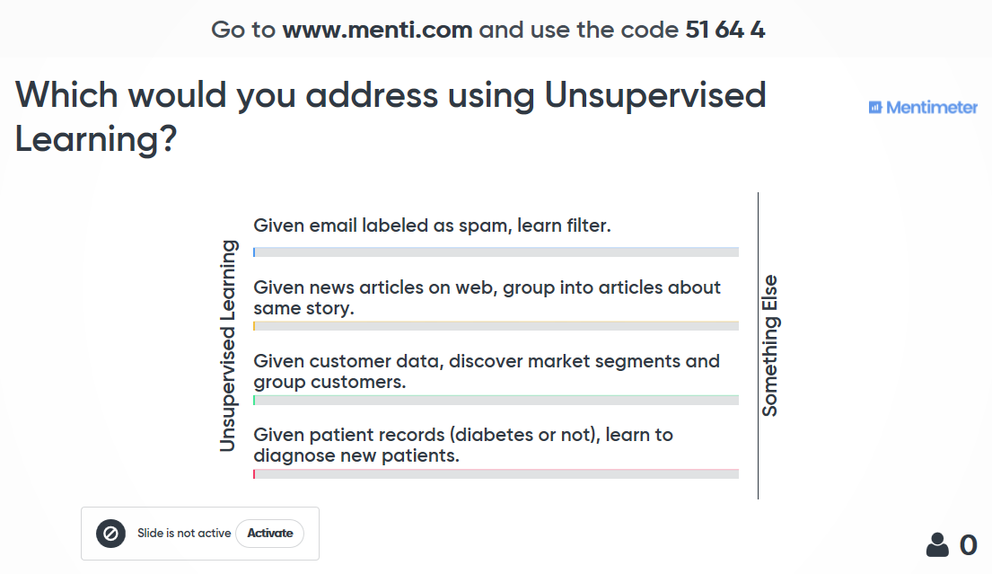

Slide 40
5. Wrap-up

Slide 41
Overview
This Talk
Overview
Supervised Learning
Unsupervised Learning
What is ML?
Wrap-up

Slide 42
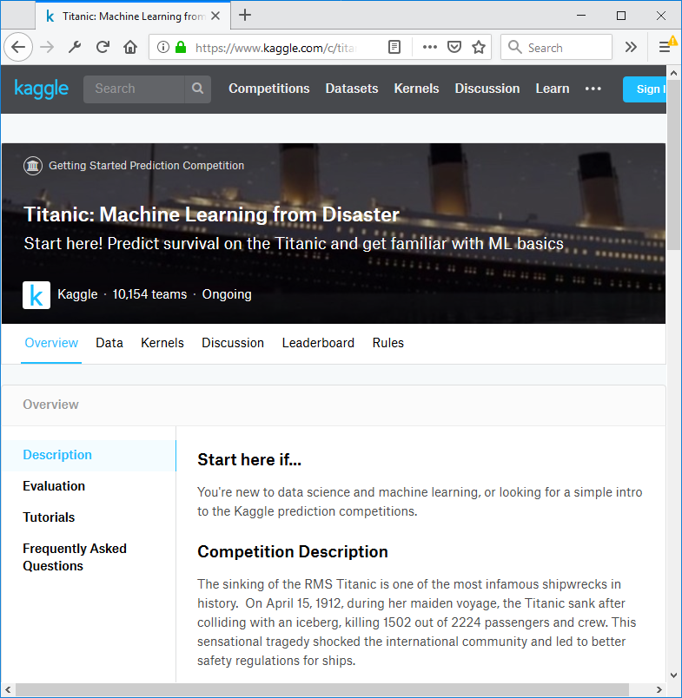
What’s Next?
Learning From Desaster https://www.kaggle.com/c/titanic
Predicting Survival of Passengers based on features e.g.,
Gender
Age
Name
Cabin number
Class of ticket
Boarding harbor
...

Slide 43
Resources

Slide 44
Resources
Machine Learning, Online Course in Coursera, Andrew Ng, Standford University, https://www.coursera.org/learn/machine-learning
Mitchell (2017) Machine Learning, McGraw Hill
Gèron (2017) Hands-On Machine Learning with Scikit-Learn and Tensor Flow: Concepts, Tools, and Techniques to Build Intelligent Systems, O’Reilly
Müller and Guido (2016) Introduction to Machine Learning with Python: A Guide for Data Scientists, O’Reilly

Slide 45
References
Christopher Cullinan, Christopher Wyant, Timothy Frattes. Computing Performance Benchmarks among CPU, GPU, and FPGA, https://web.wpi.edu/Pubs/E-project/Available/E-project-030212-123508/unrestricted/Benchmarking_Final.pdf
Lee, S.I., Pe'er, D., Dudley, A.M., Church, G.M. and Koller, D., 2006. Identifying regulatory mechanisms using individual variation reveals key role for chromatin modification. Proceedings of the National Academy of Sciences, 103(38), pp.14062-14067.
Lee, T.W., Ziehe, A., Orglmeister, R. and Sejnowski, T., 1998, May. Combining time-delayed decorrelation and ICA: Towards solving the cocktail party problem. In Acoustics, Speech and Signal Processing, 1998. Proceedings of the 1998 IEEE International Conference on (Vol. 2, pp. 1249-1252). IEEE. Audio samples available at http://cnl.salk.edu/~tewon/Blind/blind_audio.html
Samuel, A.L., 1959. Some studies in machine learning using the game of checkers. IBM Journal of research and development, 3(3), pp.210-229.

Slide 46
Appendix

Slide 47
Annual Salary src: indeed.com, average USD/year across USA, 15 Nov 2018

